Slide 1
MECHANICAL ENERGY
& WORK
YEAR 9 SCIENCE
2025

Slide 2
LEARNING INTENTIONS
Understand the relationship between energy and work
Perform simple calculations using energy and work
Perform simple calculations using kinetic and gravitational potential energy equations

Slide 3
WORK

Slide 4
WHAT IS ‘WORK’?
Definition:
When a force acts upon an object to cause a displacement of the object, it is said that work was done upon the object.

Slide 5
ARE THESE EXAMPLES OF WORK?
A teacher applies a force to a wall and becomes exhausted.
A book falls off a table and free falls to the ground.
A rocket accelerates through space.
A waiter carries a tray full of meals above his head by one arm straight across the room at constant speed.

Slide 6
ARE THESE EXAMPLES OF WORK?
A teacher applies a force to a wall and becomes exhausted.
A book falls off a table and free falls to the ground.
A rocket accelerates through space.
A waiter carries a tray full of meals above his head by one arm straight across the room at constant speed.
No, this is not an example of work. The wall is not displaced. A force must cause a displacement in order for work to be done.
Yes, this is an example of work. There is a force (gravity) which acts on the book which causes it to be displaced in a downward direction (i.e., "fall").
Yes, this is an example of work. There is a force (the expelled gases push on the rocket) which causes the rocket to be displaced through space.
No, this is not an example of work. There is a force (the waiter pushes up on the tray) and there is a displacement (the tray is moved horizontally across the room). Yet the force does not cause the displacement. To cause a displacement, there must be a component of force in the direction of the displacement.

Slide 7
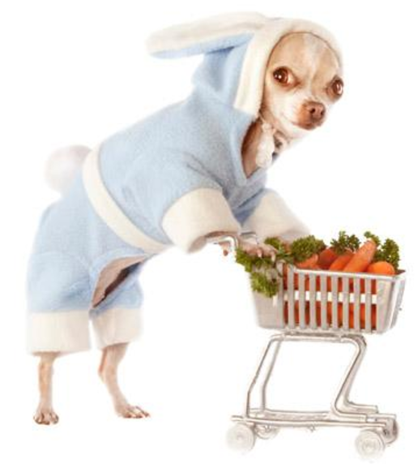
ENERGY IS NEEDED TO DO WORK!
Eg: pushing a shopping cart involves exerting force to move it over the ground.
The equation used to illustrate this is:
WORK = FORCE x DISPLACEMENT
(J or Nm) (N) (m)
W = F x s

Slide 8
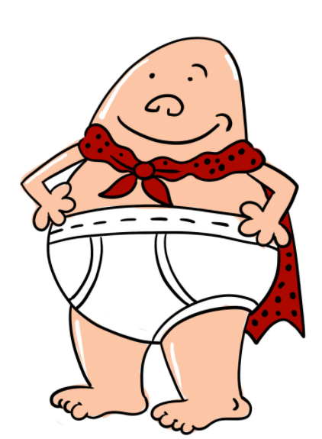
WORK and its relationship to ENERGY
For example, Captain Underpants picks up a Y10 student who weighs 650N and throws them a distance of 100m.
How much work was done?
W = F x s
= 650 x 100
= 65,000 J (Joules)
Or 65,000 Nm (Newton meters)
When work is done, potential energy is transferred to kinetic energy.

Slide 9
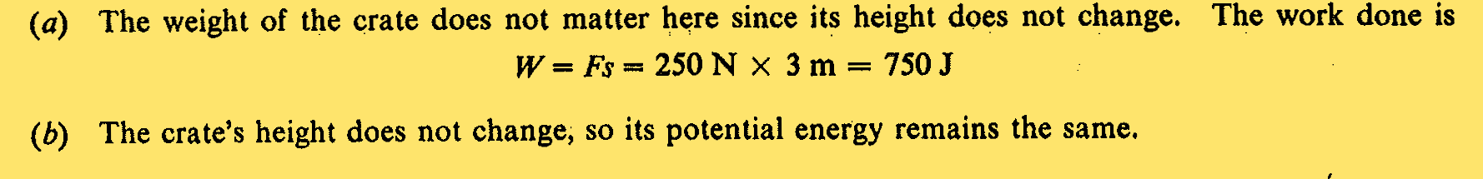
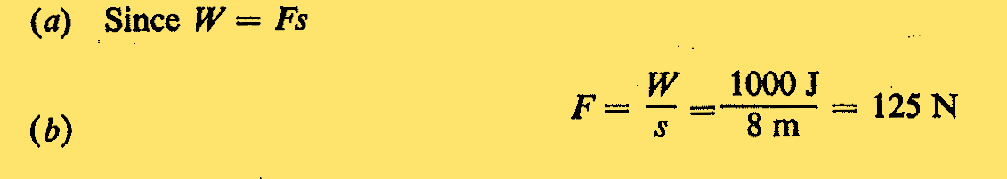
PRACTICE QUESTIONS:

Slide 10
MECHANICAL ENERGY

Slide 11
MECHANICAL ENERGY (E_{mech})
Mechanical energy is the total energy an object possesses due to its motion and position (sum of its kinetic energy and potential energy). This energy can be converted between the two forms, such as when a pendulum swings, or an object is falling.
Therefore: E_{mech}= E_{k} + E_{p}
Kinetic Energy: The energy an object has because of its motion.
Can you provide 3 examples?
Potential Energy: The stored energy an object has because of its position or state.
Can you provide 3 examples?

Slide 12
Kinetic & potential energy – calculations
Need a calculator!

Slide 13
Using energy equations
We can determine how much gravitational potential energy an object has gained if we know it’s mass in kilograms, and it’s height from the ground in meters.
The equation we use to determine the gravitational potential energy of an object is given by:
E_{p} = m x g x h
where
E_{p} = gravitational potential energy of object (in Joules)
m = mass of the object (in kilograms)
g = gravitational field strength (which on earth is always 9.81N/kg)
h = height of object (in metres)
We can use the delta symbol to show ‘a change in’. It looks like this Δ, so using the equation above, we can write it like this:
ΔE_{p} = mgΔh

Slide 14


E_{p}: example question 1
A supermarket employee lifts a baked bean tin, weighing 250 g, from the floor, to a shelf 2 m high.
How much gravitational potential energy does it gain?
(g = 9.81 N kg⁻¹)
ΔEp = mgΔh
= 0.250 × 9.81 × 2
=
4.9 J
Notes:
‹#›
Boardworks AS Physics
Title of presentation

Slide 15
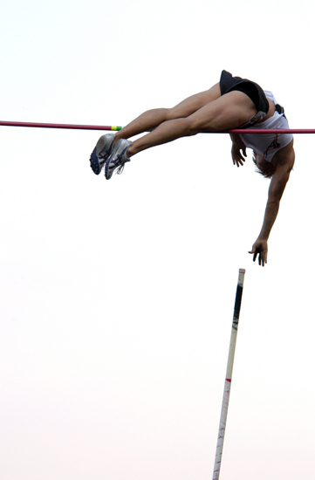
E_{p}: example question 2
A pole vaulter of mass 80 kg jumps a height of 5 m. What is his gravitational potential energy at the highest point of his jump?
(g = 9.81 N kg⁻¹)
E_{p} = mgh
= 80 × 9.81 × 5
= 3924 J
Notes:
Photo credit: © shutterstock.com / Vladimir Wrangle
‹#›
Boardworks AS Physics
Title of presentation

Slide 16
What is kinetic energy?
Kinetic energy (KE or E_{k}) is the energy of an object due to its speed.
kinetic energy = ½ × mass × speed²
E_{k} = ½mv²
Where:
kinetic energy is measured in joules (J)
mass is measured in kilograms (kg)
speed is measured in metres per second (ms⁻¹).

Slide 17
Practise questions using E_{P} and K_{E}: (20 mins)
A 70 kg rock sits on a hill 20m high. Find its potential energy.
The potential energy of a brick resting on the edge of a building is 65,000 joules. If the brick has a mass of 15 kg, how high is the building.
Find the kinetic energy of a cat which has a mass of 3kg and runs at a speed of 4m/s.
The kinetic energy of a roller-coaster car is 23,000 joules. If is is moving at a speed of 25 m/s, find the mass of the roller-coaster.
What is the kinetic energy of a car that has a mass of 2,400 kg and is moving at 20 m/s? How does this kinetic energy compare to the kinetic energy of a car with a kinetic energy of 240,000 J?
What is the kinetic energy of a 4,000 kg elephant that is running at 2 m/s?
and another elephant with the same mass running at 4 m/s How do the two kinetic energies compare with one another?
What is the kinetic energy of a 2,000 kg bus that is moving at 30 m/s?
What is the kinetic energy of a 3,000 kg bus that is moving at 20 m/s?
What is the gravitational potential energy of a diver whose mass is 60kg standing on a platform that is 10 m off the ground?
PEPK Practise worksheet to do next

